Slide 1
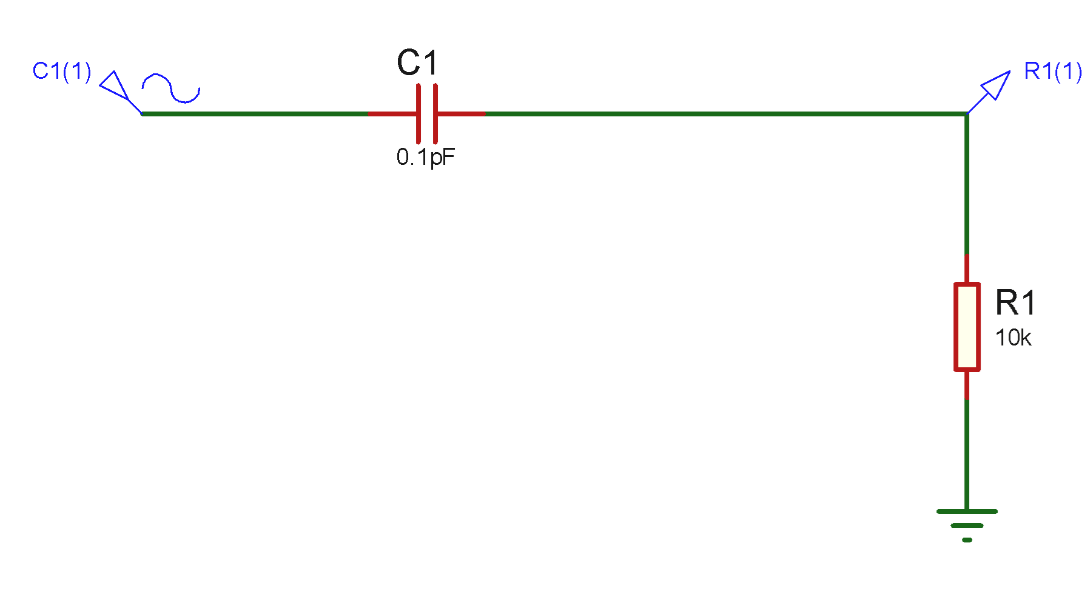
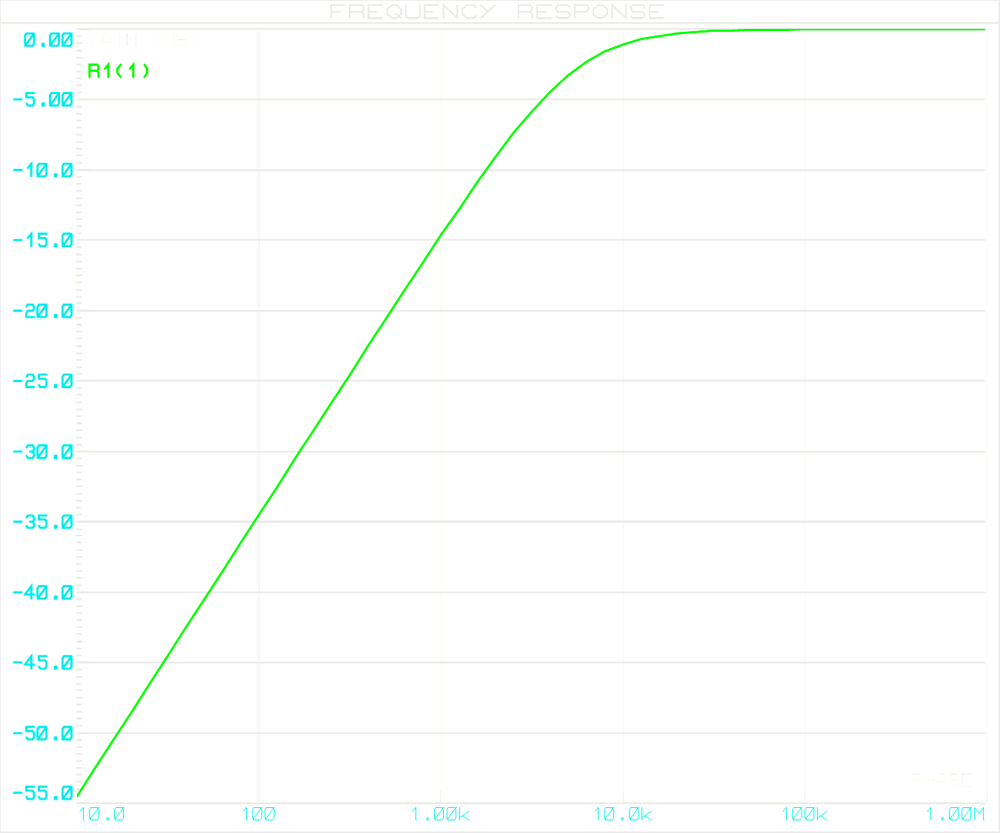
Buda Tech
Passive High Pass Filter

Slide 2
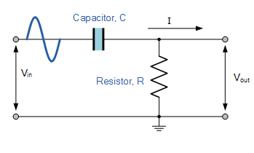
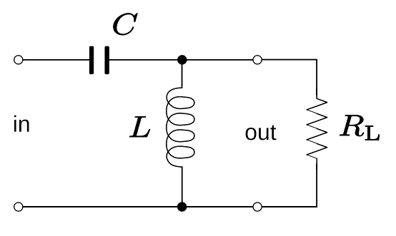
Buda Tech
What Is a Passive High Pass Filter?
The high pass filter only allows high frequency signals from its cut-off frequency, ƒc point to pass while blocking those any lower.
Passive High Pass Filter Construction
In low frequency applications (up to 100kHz), passive HPF are constructed using simple RC (Resistor-Capacitor) networks,
while higher frequency filters (above 100kHz) are usually made from RLC (Resistor-Inductor-Capacitor) components.

Slide 3
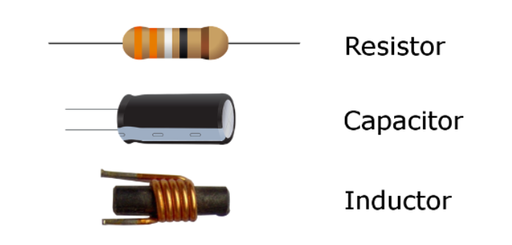
Buda Tech
Passive High Pass Filter Components
Passive filters are composed of passive components, including resistors, capacitors, and inductors, and lack amplifying elements (such as transistors and op-amps), resulting in no signal gain. Consequently, their output level is always lower than the input.
No Gain
Input
The output is less than the Input
Passive Component
Therefore, passive HPF ( RC & RLC) filters attenuate the signal and have a gain of less than one (unity).

Slide 4

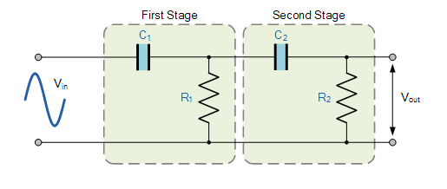
Buda Tech
Passive High Pass Filter order
1st Order Passive HPF
2nd Order Passive HPF

Slide 5
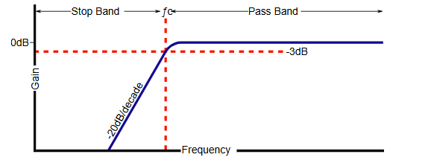
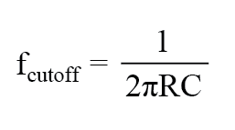
First order Passive HPF
Buda Tech
Cut-off” or “corner” frequency.
The frequency at which the transition occurs.
is the point at which signals above this frequency are allowed to pass with minimal to no weakening/attenuation.
HPF cut-off” or “corner” frequency.
First order cutoff frequency

Slide 6

Buda Tech
Capacitive Reactance ( X_{C} )
The opposition a capacitor offers to the flow of alternating current (AC).
The resistor remains constant as the frequency changes. At low frequencies, the capacitive reactance ( X_{C} ) of the capacitor will be very large compared to the resistive value of the resistor.
$$x_{c}=\frac{1}{2πfC}$$
$x_{c}$ is inversely proportional to frequency

Slide 7

Buda Tech
$$x_{c}=\frac{1}{2πfC}$$
At low frequency.
Voltage potential, V_{C} across the capacitor will be much larger than the voltage drop, V_{R} developed across the resistor
At high frequency.
V_{C} being small and V_{R} being large due to the change in the capacitive reactance value.

Slide 8
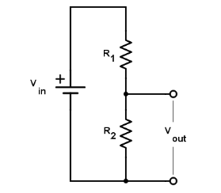
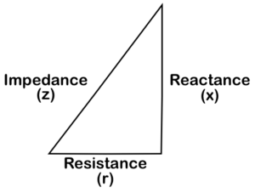


Buda Tech
Formula
Voltage divider network
HPF RC network
$$x_{c}=\frac{1}{2πfC}$$
Impedance Triangle
$$Vo = Vi\left(\frac{R_{2}}{R_{1}+R_{2}}\right)$$
$$R_{1}+R_{2}=RT$$
$$\sqrt{R^{2}+{x_{c}}^{2}}=Z$$

Slide 9


Buda Tech
Formula
HPF RC network
$$x_{c}=\frac{1}{2πfC}$$
$$\sqrt{R^{2}+{x_{c}}^{2}}=Z$$
$$Vo = Vi\left(\frac{x_{c}}{\sqrt{R^{2}+{x_{c}}^{2}}}\right)$$
$$Vo = Vi\left(\frac{x_{c}}{Z}\right)$$

Slide 10
Buda Tech
High Pass Filter Example
Calculate the cut-off or “breakpoint” frequency ( ƒc ) for a simple passive high pass filter consisting of an 82pF capacitor connected in series with a 240kΩ resistor.
Data
Resistor = 240kΩ
capacitor = 82pF
fc = ?.

Slide 11



Buda Tech
Data
Resistor = 240kΩ
capacitor = 82pF
.
$$f_{c}=\frac{1}{2πRC}$$
$$f_{c}=\frac{1}{2 x π x 240k x 82p}$$
$$f_{c}=\frac{1}{2 x π x 82 x{10}^{−12}x 240 x{10}^{3}}$$
$$f_{c}=\frac{1}{1.23653 x{10}^{−4} }$$
$$f_{c}{ C}_{}$$
$$f_{c}=8087Hz=8kHz$$

Slide 12
Buda Tech
Frequency Response Curve or Bode Plot of HPF
Gain in dB
Blocked
Allowed
Frequency Hz
fc
cut off frequency

Slide 13
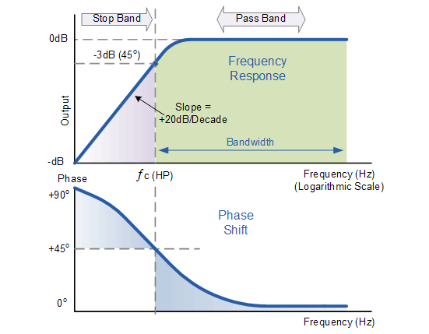
Buda Tech
Frequency Response Curve or Bode Plot

